Slide 1
Chapter 9: Multiple Linear Regression
Return to cereals data. Previously, used simple linear regression to fit relationship between nutritional rating (target or response variable) and sugars (predictor or explanatory variable). But there were other possible explanatory variables in the dataset:
name | calories | protein | fat | sodium | fiber | carbo | sugars | rating
100% Bran | 70 | 4 | 1 | 130 | 10 | 5 | 6 | 68.402973
100% Natural Bran | 120 | 3 | 5 | 15 | 2 | 8 | 8 | 33.983679
All-Bran | 70 | 4 | 1 | 260 | 9 | 7 | 5 | 59.425505
All-Bran with Extra Fiber | 50 | 4 | 0 | 140 | 14 | 8 | 0 | 93.704912
Almond Delight | 110 | 2 | 2 | 200 | 1 | 14 | 8 | 34.384843
Apple Cinnamon Cheerios | 110 | 2 | 2 | 180 | 1.5 | 10.5 | 10 | 29.509541

Slide 2
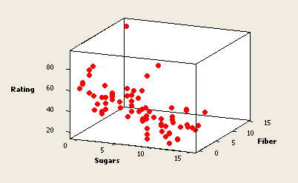

Example: nutritional rating on sugars and fiber
Scatterplot in 3 dimensions. Find best-fitting plane to data.
High fiber level associated with high rating
High sugar level associated with low rating
Fitted Model:

Slide 3
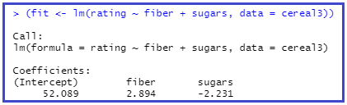
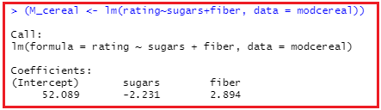
Using lm to find best fitting plane – min SSE

Slide 4
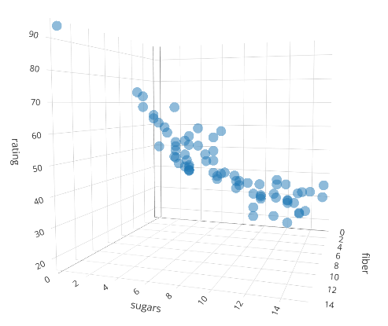
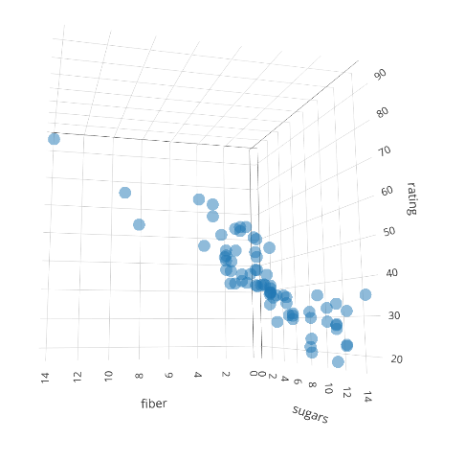
install.package(“plotly”) library(plotly)
plot_ly(data = cereal, z = ~ rating, y = ~sugars, x = ~fiber,
opacity = 0.5) %>%
add_markers()

Slide 5
Fitting least-squares plane
(fit <- lm(rating ~ sugars+ fiber, data = cereal3))
plot_ly(data = cereal3, z = ~rating, y = ~sugars, x = ~fiber, opacity = 0.5) %>%
add_markers()
x <- seq(0,15,by = 0.01)
y <- seq(0,15,by = 0.01)
plane <- outer(x,y,function(a,b){fit$coefficients[1]+fit$coefficients[2]*a+fit$coefficients[3]*b})
plot_ly(data = cereal3, z = ~rating, x = ~fiber, y = ~sugars, opacity = 0.5) %>%
add_markers() %>%
add_surface(x = ~x, y = ~y, z = ~plane, showscale = FALSE)

Slide 6
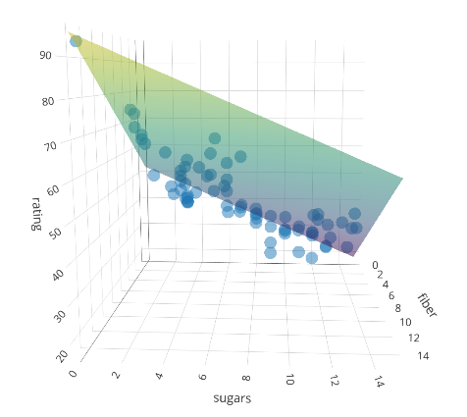
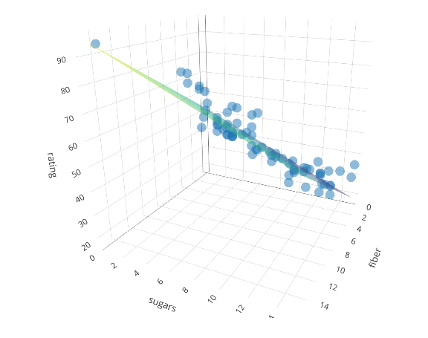
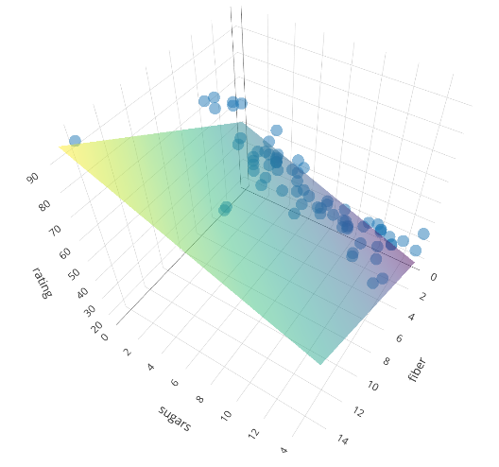


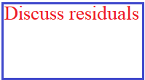


Interactive: Sample Plots

Slide 7
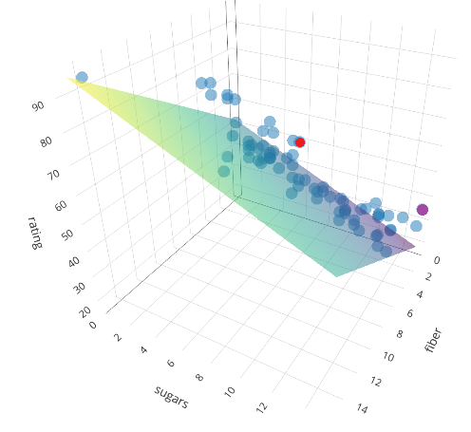
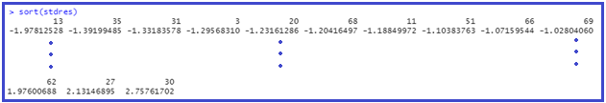
Outliers, leverage, influential points
stdres <- rstandard(fit)
leverage <- hatvalues(fit)
D <- cooks.distance(fit)
Outliers: Sort standardized residuals, any >2?
Frosted Mini-Wheats: sugars = 7, fiber = 3, rating = 58.345
Golden Crisp: sugars = 15, fiber = 0, rating = 35.252

Slide 8

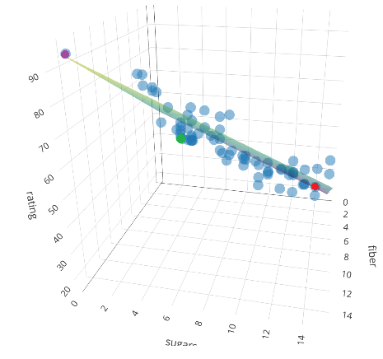

Leverage and Influential Points
High leverage: sort leverages – high leverage > 2(2+1)/73 or 0.0827
#50 Post Nat. Raisin Bran: sugars = 14, fiber = 6, rating = 37.841(red)
#3 All-Bran: sugars = 5, fiber = 9, rating = 59.426 (green)
#1 100% Bran: sugars = 2, fiber = 8, rating = 33.984
#4 All-Bran with Extra Fiber: sugars = 0, fiber = 14, rating = 93.705 (purple)
Influential points

Slide 9







Inference: Model
Assumptions:
Zero-Mean Assumption:
Constant variance Assumption:
Independence Assumption:
Normality Assumption:

Slide 10
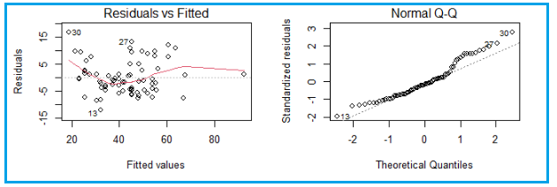
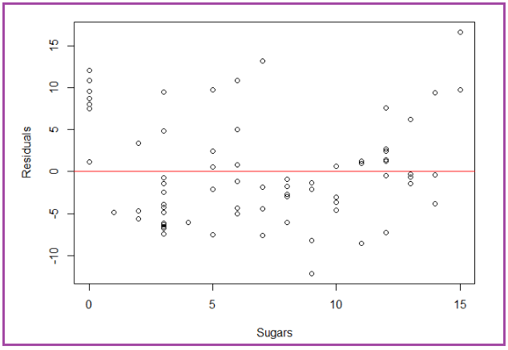
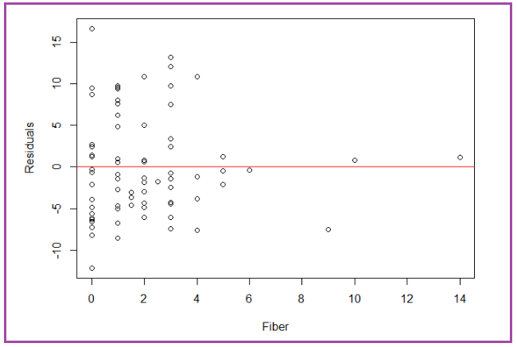
t-tests for model coefficients
Check assumptions
par(mfrow=c(2,2))
plot(fit)
par(mfrow=c(1,1))

Slide 11

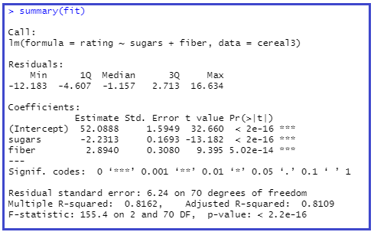

t-tests for model coefficients (continued)

Slide 12
F-Test for Significance of the Overall Regression Model
F-test: linear relationship between target variable y and the set of predictor variables , taken as a whole.
For our case: linear relationship between rating and {sugars, fiber}.
General case:
Model for H₀:
For the test, need to return to ANOVA and Sum of Squares:
SSE, SSR, SST: SST = SSE + SSR

Slide 13

ANOVA Table
Recall SSE measures overall estimation error
Three Sum of Squares formulas defined:
Regression statistics shown in ANOVA table, where m = number of predictors
42.77
Source of Variation | Sum of Squares | Degrees of Freedom | Mean Square | F
Regression | SSR | m
Error (or Residual) | SSE
Total

Slide 14
F-test for Significance of Overall Regression Model (cont’d)
Observed F-statistic F_{obs} = MSR/MSE follows F_{m, n-m-1} distribution
F-test is right-tailed test, since values non-negative
Ho rejected when p-value small
Where p-value = p(F_{m, n-m-1} > F_{obs}), represents area in tail to right of observed value

Slide 15
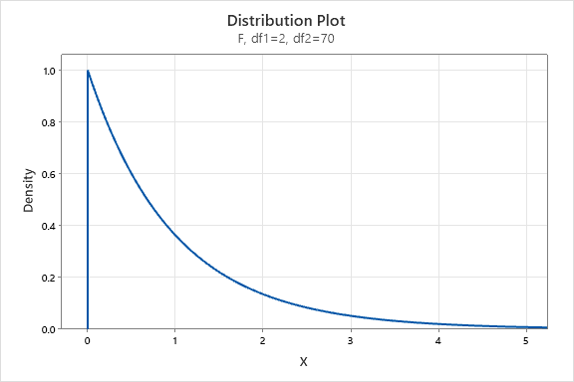
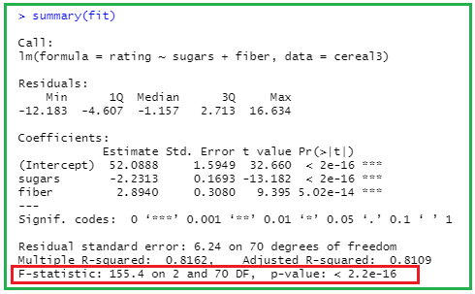
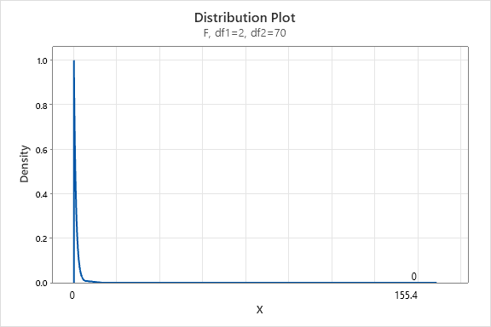

Cereals: F-Test

Slide 16
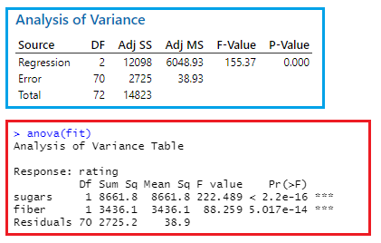
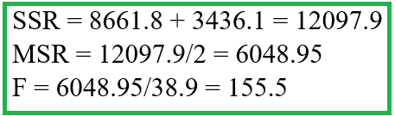
ANOVA Table: F-Test

Slide 17
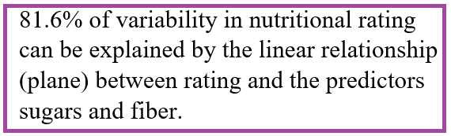
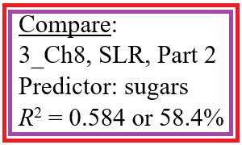

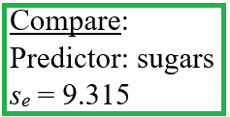
Add slide about R² and s_{e}

Slide 18
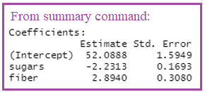
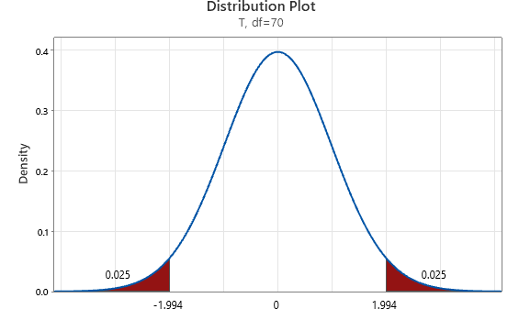

Confidence Interval for Particular Coefficient, β_{i}
100(1-alpha)% confidence interval for coefficient β_{i}, where t_{n-m-1} based on n-m-1 degrees of freedom:
We are 100(1-alpha)% confident true slope β_{i} lies within interval
Example: Construct 95% confidence interval for β₁, for sugars
b₁ = –2.2313, and s_{b1}= 0.1693
t*=1.9944
Therefore, confidence interval equals –2.2313 ± (1.9944) (0.1693) = (–2.569, –1.894)

Slide 19
Confidence Interval for Particular Coefficient, β_{i} (cont’d)
We are 95% confident β₁ lies between -2.57 and -1.89
For every gram of additional sugar, nutritional rating will decrease between 1.89 and 2.57 rating points, when fiber held constant
Suppose researcher claims rating falls two points, for every additional gram sugar, when fiber held constant
Because 2.0 lies within 95% confidence interval, we would not reject this assertion, with 95 percent confidence

Slide 20
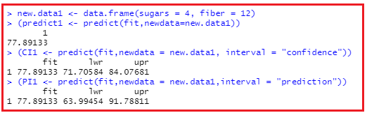
Confidence Interval for Mean Value of y, Given x₁, x₂, …, x_{m}
sugars = 4, fiber = 12: point estimates for mean value of rating and rating are analogous to simple linear regression case. Just plug into formula for plane.
Confidence interval and prediction interval is multivariate extension but requires matrix multiplication. But the predict command in R works the same way as it did in simple linear regression.

